Slide 1
PICTORIAL VIEWS AND PROJECTIONS
Classifications:
Axonometric Projection
Oblique Projection
Perspective Projection
Axonometric Projection
Isometric Projection
Dimetric Projection
Trimetric Projection

Slide 2
ISOMETRIC PROJECTION
Principles of Isometric Projection
Isometric Scale
Isometric Drawing (View)
Positioning of Isometric Axes
Centre and Dimension lines

Slide 3
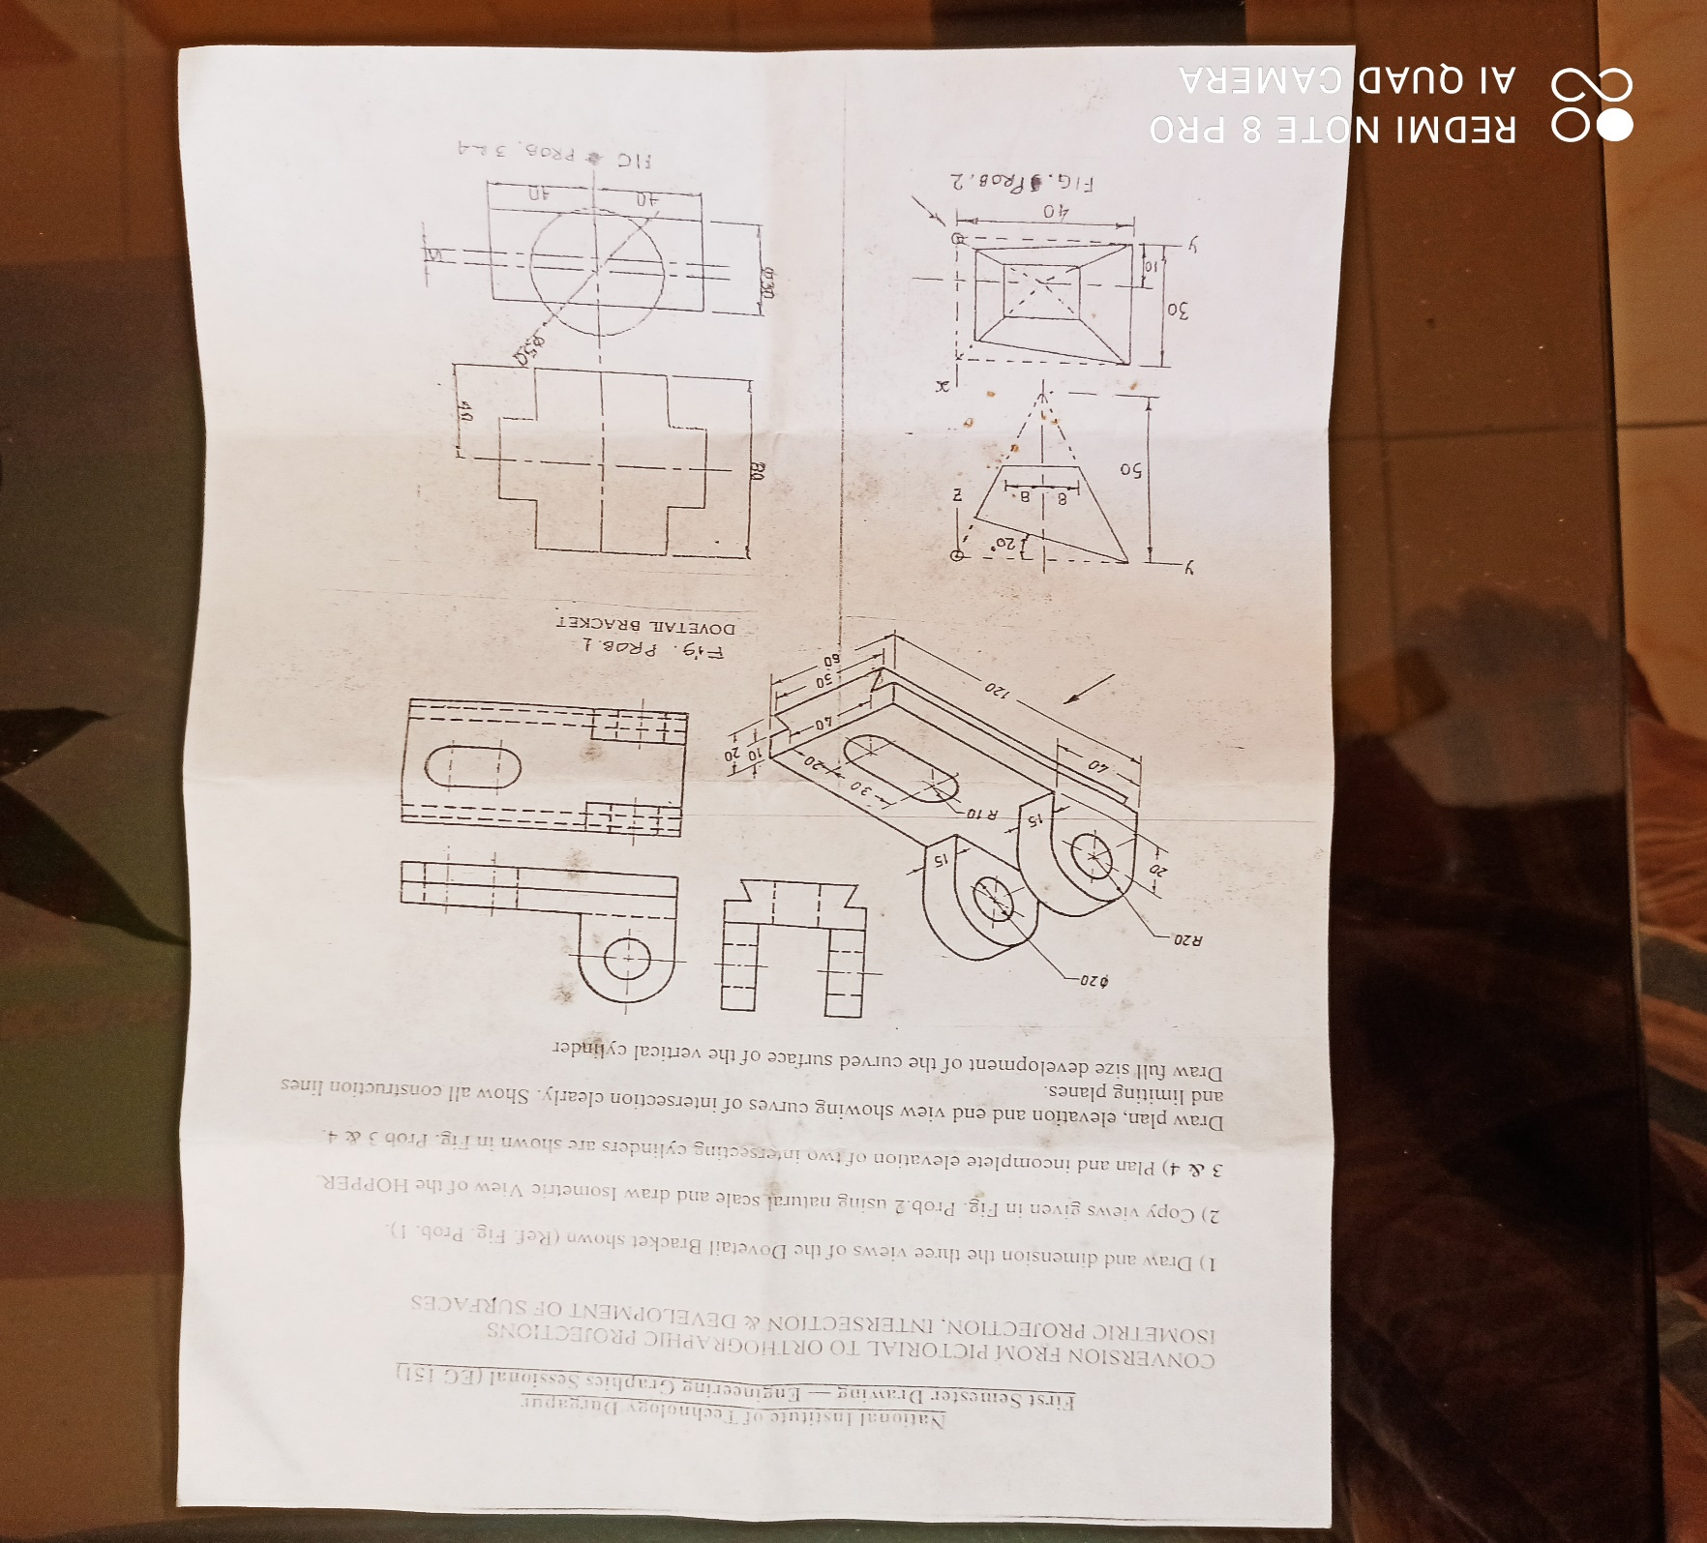
PLATE NO. 5

Slide 4
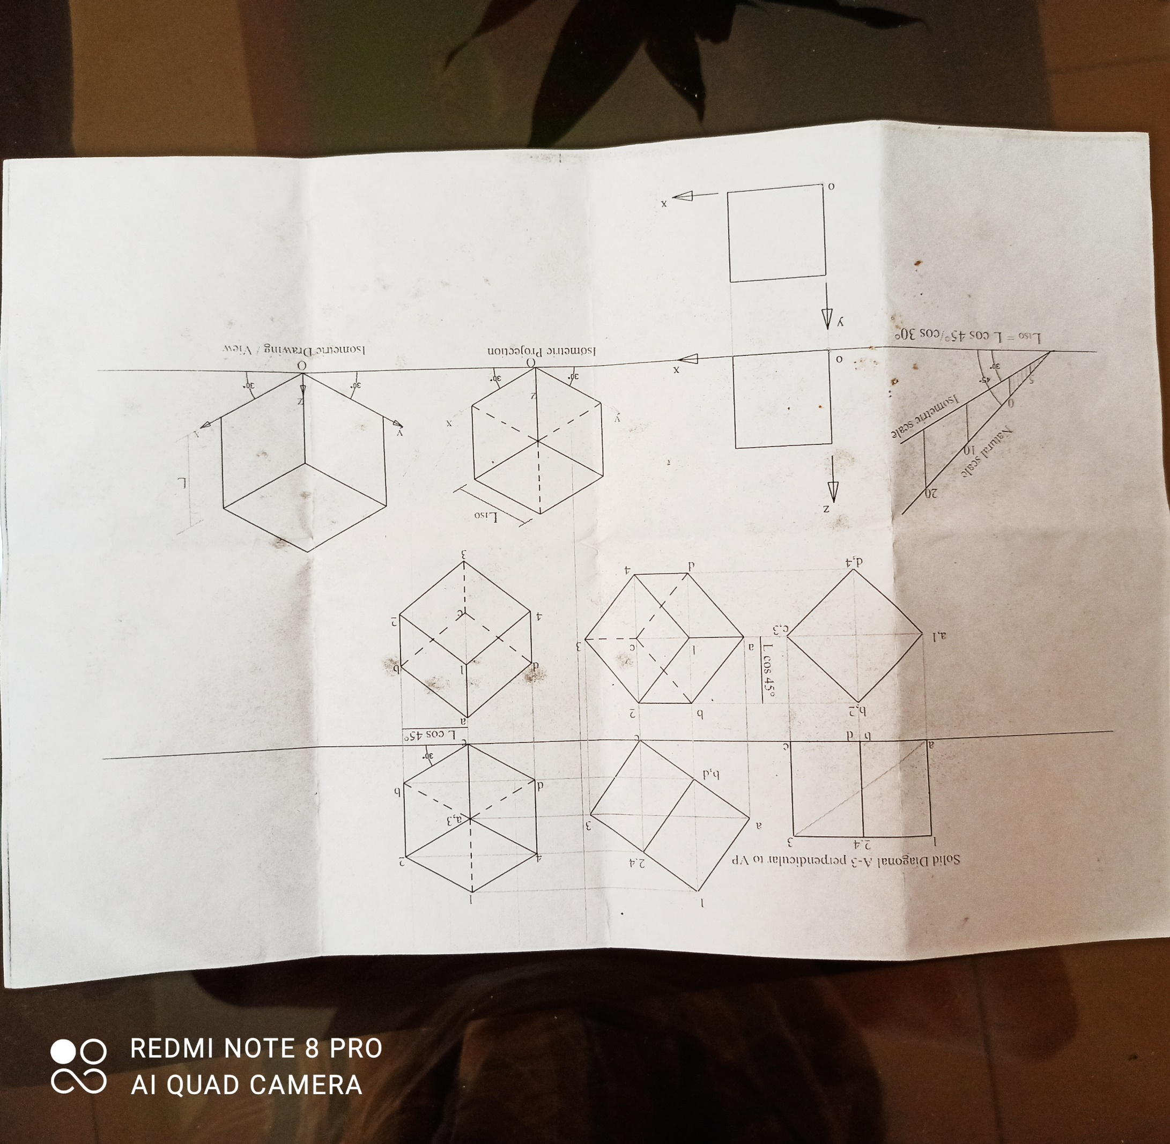
PLATE NO. 5

Slide 5
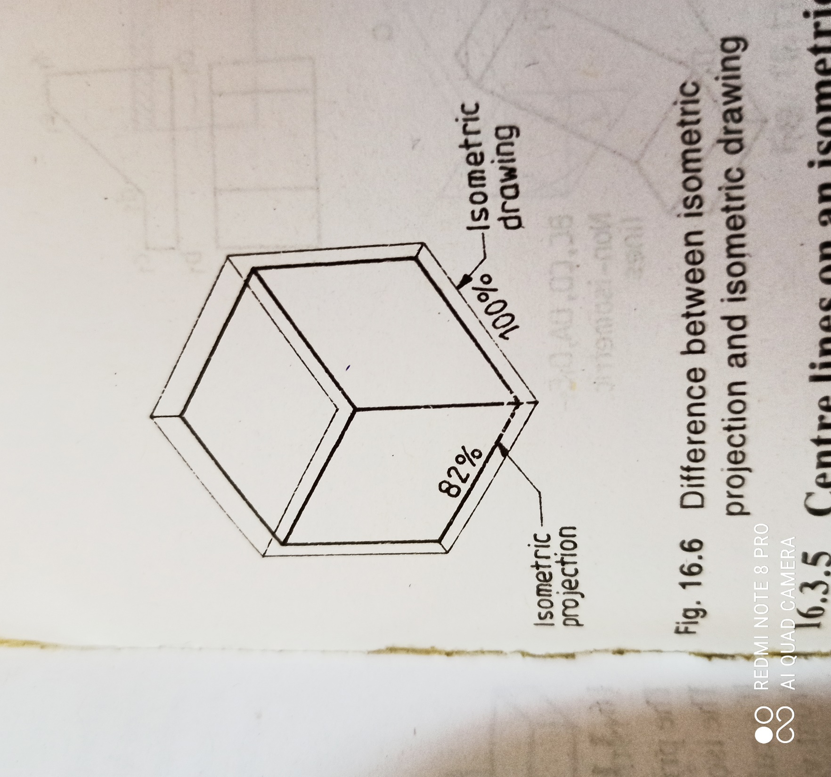
ISOMETRIC PROJECTION AND DRAWING

Slide 6
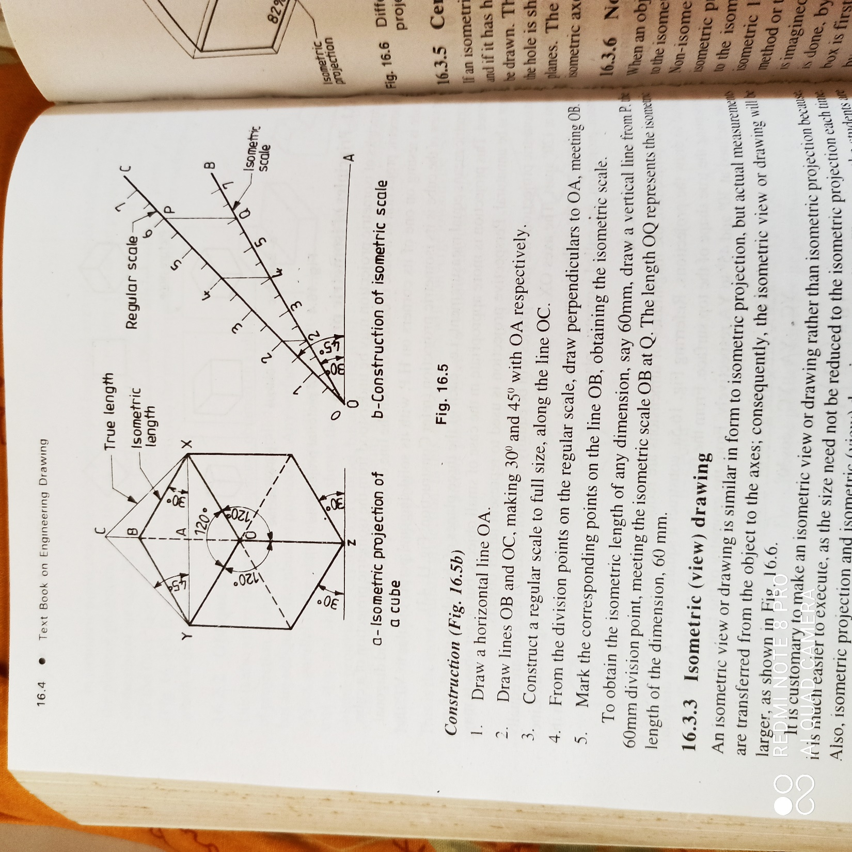
ISOMETRIC PROJECTION AND DRAWING

